Slide 1

AI Journey
Past, Present, and Future
An Introduction to Artificial Intelligence
The Genesis of Intelligence
AI in Our World Today
Envisioning Tomorrow
For College Students | August 24, 2025

Slide 2




Our Journey Through Intelligence
Exploring the origins, applications, and future of artificial intelligence
The Past
AI's core concept and foundations Historical milestones
The challenges of early AI
The Present
Everyday AI applications Machine learning basics Ethical considerations
The Future
Emerging AI trends Transformative projects Your role in shaping AI
Key Questions We'll Explore:
How did AI begin and what are its foundations?
What possibilities and responsibilities does AI create?
How does AI work in our daily lives?

Slide 3






The Genesis of Intelligence
The birth of a new era in human technology
Artificial Intelligence is the science and engineering of creating intelligent machines, especially intelligent computer programs. It's the endeavor to build systems that can perform tasks that typically require human intelligence.
Learning
Systems that can learn from experience and adapt to new circumstances
Language
Understanding and
generating human language for communication
Patterns
Recognizing complex patterns in data that humans might miss
Decision Making
Solving problems and making decisions based on available information
The Goal of Artificial Intelligence
The ultimate goal is to create tools that can augment human capabilities and help us tackle challenges too complex or vast for the human mind alone.

Slide 4
AI's Core Concept
Systems designed to perceive, reason, and act by learning
AI is the science of creating intelligent machines that perform tasks requiring human intelligence.
Traditional Programming
AI Programming
Explicit rules for every scenario
Provide examples and labels
VS
Stop sign example: IF shape=octagon AND color=red THEN stop_sign=True
Show computer thousands of stop sign and non-stop sign images
Fails when sign is faded or at angle
AI creates its own rules based on patterns
Key insight: AI learns by example, like teaching a child to identify a stop sign.

Slide 5





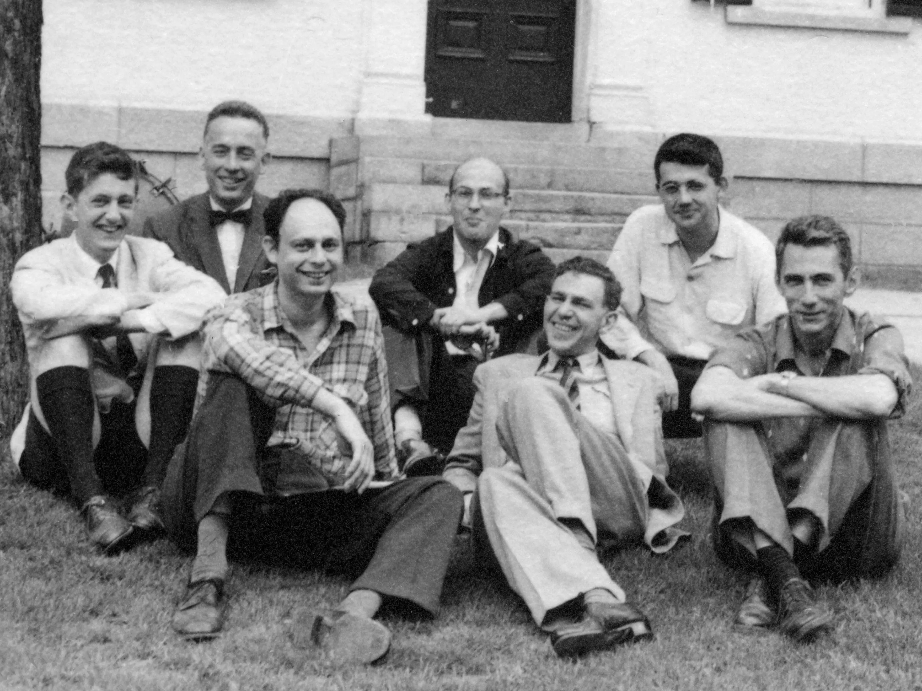

Historical Milestones
The key moments that shaped the birth of artificial intelligence
1950 The Turing Test
Proposed by Alan Turing, this test challenged the definition of intelligence. It suggested a machine could be considered "thinking" if it could hold a conversation indistinguishable from a human's.
1956 Dartmouth Workshop
A group of pioneering scientists gathered for a summer-long workshop, where the term "Artificial Intelligence" was officially coined. This event is widely considered the birth of AI as a formal field of research.
1965 ELIZA Chatbot
1969 General Problem Solver
This program demonstrated a problem-solving approach that separated strategy from specific problems.
Created at MIT, ELIZA was one of the first programs capable of processing natural language. It simulated a psychotherapist and showed the potential for human-computer interaction.
1972 Dendral Expert System
An early "expert system" that could identify unknown organic molecules, showing AI's potential in scientific applications.

Slide 6

Early AI Breakthroughs
Pioneering systems that demonstrated AI's potential
ELIZA Chatbot
1965, MIT
General Problem Solver
1969
Dendral Expert System
1972
Function: Natural language processing
Function: Problem-solving
Function: Scientific analysis
Achievement: Simulated a psychotherapist
Achievement: Separated strategy from specific problems
Achievement: Identified unknown organic molecules
Impact: Demonstrated human- computer interaction potential
Impact: Foundation for modern AI approaches
Impact: Proved AI's practical applications in science
"These early systems showed that AI could solve real-world problems, laying the groundwork for today's sophisticated AI applications."

Slide 7
The AI Winters
Periods of reduced funding and interest when AI progress stalled
1974 1980
1987
1993
Present
First AI Winter (1974-1980)
Causes:
Researchers overpromised on what AI could deliver Computational power needed for complex tasks was
unavailable
Second AI Winter (1987-1993)
Causes:
Collapse of market for specialized AI hardware
Expert systems proved brittle outside narrow expertise
Impact:
Cheaper and more powerful desktop computers began to
dominate the market, making specialized AI machines obsolete.
Impact:
Government agencies in the U.S. and U.K. cut funding for undirected AI research, leading to a significant slowdown in the field.
Key Takeaways:
AI Winters were critical reality checks that exposed the limitations of existing approaches
These periods forced the field to mature and develop more rigorous approaches

Slide 8
Lessons from the Past
How AI winters shaped the foundation for modern artificial intelligence
Patience as a Marathon
Building intelligence is a marathon, not a sprint. Progress requires years of dedicated research and incremental improvements.
Rigorous Scientific Methods
More robust theoretical foundations were developed, moving from optimistic speculation to mathematically- grounded approaches.
Humility in Complexity
The winters taught researchers to acknowledge the
immense complexity of creating true intelligence and to approach problems with humility.
Machine Learning Emergence
The seeds of persistence planted during these winters
gave rise to machine learning approaches that would later transform the field.
"The lessons learned from these early decades were profound. The AI Winters, though challenging, forced the field to mature."

Slide 9

AI in Our World Today
From research labs to everyday life
AI is no longer confined to research labs; it's in your pocket, on your screen, and all around you.
Personalized Recommendations
Netflix suggests movies and Spotify creates playlists based on your preferences
Smart Assistants
Siri and Alexa use NLP to understand and respond to your commands
Navigation & Mapping
Google Maps and Waze analyze traffic data to provide real-time directions
Next We'll Explore
Everyday AI Applications
Machine Learning Basics
Ethical Considerations
Cutting-Edge Research

Slide 10





Everyday AI Applications
AI is no longer confined to research labs—it's an integral part of our daily routines
Personalized Recommendations
When Netflix suggests a movie you end up loving or Spotify curates the perfect playlist for your mood, that's AI at work. These platforms analyze your past behavior and compare it with millions of other users to predict what you'll enjoy next.
Smart Assistants & NLP
Voice assistants like Siri and Alexa use Natural Language Processing (NLP) to understand and respond to your spoken commands. This same technology powers the conversational abilities of tools like ChatGPT, allowing us to interact with computers in a more human way.
Navigation and Mapping
Apps like Google Maps and Waze use AI to analyze real- time traffic data, predict congestion, and calculate the fastest route. They learn from the collective data of all users to provide dynamic, up-to-the-minute directions.
Facial Recognition
The ability to unlock your phone with your face or have social media automatically tag your friends in photos is a direct application of AI-powered computer vision. These systems analyze facial features and compare them to databases to identify individuals.
These systems work quietly in the background to make daily life more convenient, personalized, and connected

Slide 11




Machine Learning Simplified
The difference between traditional programming and learning from examples
Traditional Programming
Machine Learning
STOP
Stop Sign
Not Stop Sign
Not Stop Sign
If shape is octagon AND color is red AND contains "STOP", then it's a stop sign.
Show thousands of images, labeling which are stop signs and which are not.
VS
Limitations:
Fails when sign is faded or at an angle
Benefits:
Learns underlying patterns on its own
Must be explicitly told what to look for
Robust against variations (faded signs, angles)
Cannot adapt to new situations
Creates its own rules and adapts
Machine Learning is like teaching by example rather than giving a rigid instruction manual

Slide 12





Ethical Considerations
Addressing the human dimensions of artificial intelligence
Algorithmic Bias
AI systems learn from the data they're given.
Privacy & Data Security
AI models require massive amounts of personal data.
Misinformation & Deepfakes
Generative AI can create highly realistic but fake content.
If this data reflects existing societal biases (e.g., in hiring or loan data), the AI can learn and amplify
these prejudices.
Who has access to our data and how it's used raises significant concerns.
"Deepfakes" enable the creation of convincing fake images, videos, and audio.
Questions about data ownership and protection from misuse become critical.
This leads to unfair outcomes that perpetuate inequality.
This poses a serious threat by enabling rapid spread of convincing misinformation and propaganda.
"Ethics is about building AI that reflects our values and benefits society."

Slide 13

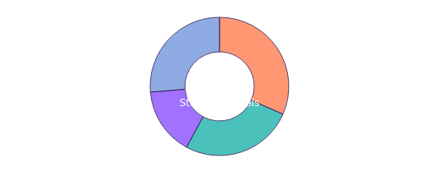
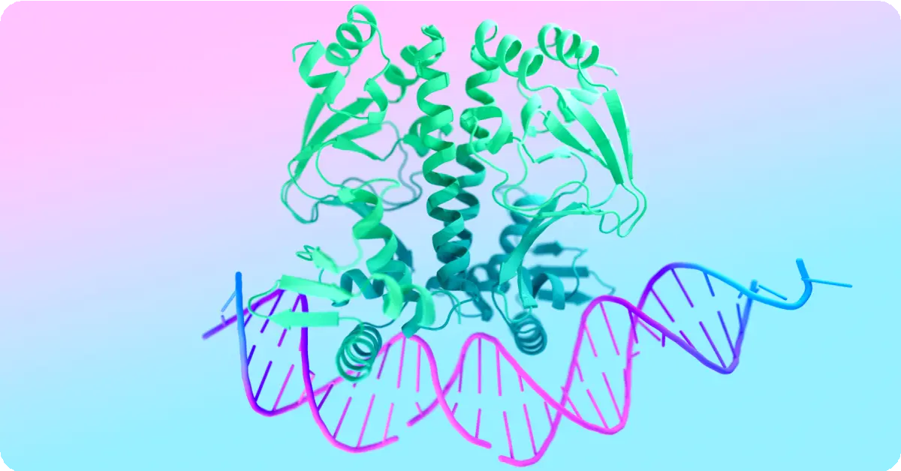

Cutting-Edge Research Today
Revolutionary AI projects pushing the boundaries of science
DeepMind's AlphaFold
A milestone in computational biology that solves the protein folding problem — predicting 3D structure from amino acid sequences.
For decades, predicting protein 3D structures was a grand challenge in biology.
Google DeepMind's GNoME
Graph Networks for Materials Exploration discovers new crystal structures using AI-driven methods.
Leverages graph neural networks to explore complex material properties.
Impact:
Enables understanding of disease mechanisms Accelerates drug discovery
Creates new possibilities in personalized medicine
Discoveries:
2.2 million new crystal structures
380,000 stable materials for future tech
Materials for batteries, solar cells, and superconductors

Slide 14

AI for Accessibility
Breaking barriers and creating an inclusive world
AI technologies are transforming accessibility, empowering individuals with disabilities and breaking down barriers to communication and participation.
Be My Eyes
Connecting blind and low-vision individuals with volunteers
Real-time Communication
Breaking down barriers for the deaf and hard of hearing
AI-powered tools help with daily tasks
Human-AI collaboration enhances capabilities
Live transcription services convert speech to text
Translation services bridge language barriers
Impact & Potential
Increasing digital accessibility Facilitating social inclusion Expanding educational opportunities
"AI has the potential to empower and include, transforming how we interact and participate in society."

Slide 15
Envisioning Tomorrow
The future of AI is not just about smarter apps, but about new capabilities that could reshape our world
A New Era of Intelligence
The AI we know today is just the beginning. The future will bring transformative changes across industries and society.
Emerging Transformative Paths
Artificial General Intelligence
AI in Healthcare
Personalized treatments and accelerated medical breakthroughs
This is where the story gets truly exciting, and it's a story you will help write.
Creating AI with human-level capabilities across multiple domains
The Future is Unwritten
The decisions we make today about how we develop and
integrate AI will have a lasting impact for generations. You are the generation that will inherit this technology and steer its course.
Sustainable AI
Explainable AI
Balancing computational needs with environmental impact
Creating transparent systems that justify their decisions
"The challenge is not just to build powerful AI, but to build wise and
beneficial AI."

Slide 16



Emerging AI Trends
Transformative directions shaping AI's future
Artificial General Intelligence
Creating AI with abilities across various tasks at a human level.
AI in Healthcare & Science
Transforming medicine and accelerating scientific discovery.
Switching contexts between different problems Reasoning abstractly like humans
Exhibiting common sense
Personalized cancer treatments Early pandemic detection
Drug discovery acceleration
Sustainable AI
Addressing computational impact while creating sustainable solutions.
Explainable AI (XAI)
Creating transparent AI systems that justify their decisions.
Green AI to reduce energy consumption Optimized energy grids
Monitoring deforestation & biodiversity
Ending "black box" algorithms Building human trust in AI
Ensuring fairness and detecting bias
"The future of AI is not just about smarter apps; it's about fundamentally new capabilities that could reshape our society."

Slide 17

Visionary Projects
Exploring the cutting edge of AI innovation
GNoME: Graph Networks for Materials Exploration
Google DeepMind's revolutionary AI system that discovered:
2.2 million new crystal structures
380,000 stable materials for future technologies
This discovery represents a volume of knowledge equivalent to
nearly 800 years of prior human research, achieved in a fraction of the time.
Generative World Models
AI systems like OpenAI's Sora demonstrate: Emerging "intuitive" understanding of physics Comprehension of object permanence Recognition of cause-and-effect relationships
These models can generate highly realistic and complex video scenes from simple text prompts.
"A critical step toward creating robots that can safely navigate and interact with the real world."
Understanding of physical world rules
Common sense reasoning capabilities

Slide 18

Your Role in AI's Future
How students can shape AI development
The future of AI isn't just about technology—it's about human values and innovation.
Critical Thinker
Question AI's fairness and privacy Examine how AI impacts society
Ethical Guardian
Advocate for responsible AI Ensure AI benefits all people
Creative Problem Solver
Apply AI to community problems Invent new AI applications
Why Your Generation Matters
You are the generation that will inherit AI and steer its course. The challenge is not just to build powerful AI, but to build wise and beneficial AI. The future of intelligence is a conversation, and your voice is essential.

Slide 19



The Chapter Yet to Be Written
The future of AI is in your hands
"The most exciting chapter is the one that has yet to be written—and it will be written by you."
Build
Create the next great algorithm or application that solves real problems
Guide
Shape ethical frameworks and ensure AI benefits all of humanity
Collaborate
Work across disciplines to integrate AI into your field of passion
Your Role in AI's Future
The future of artificial intelligence doesn't just belong to computer scientists and engineers. It needs artists, ethicists, sociologists, doctors, and dreamers. It needs your curiosity, your critical perspective, and your creativity.
What will you build?
AI Journey: Past, Present, and Future

